Slide 1

Sign Language Recognition System
SRM Institute of Science and Technology
College of Engineering & Technology | School of Computing
Department of Computing Technologies
18CSC305J Artificial Intelligence – Mini Project
Team Members
RA2111027010006 Safal Mehrotra
RA2111027010007 Gaurang Ashava
RA2111027010008 Syed Adnan Hussainy
RA2111027010009 Rahul Nair

Slide 2
Abstract
Introduces AI approach for sign language recognition.
Uses CNNs and RNNs in a multimodal framework.
Processes spatial and temporal features from sign language videos.
Shows promising results in gesture interpretation.
Validates effectiveness through extensive experimentation.
Aims to improve accessibility for the deaf and hard-of-hearing.

Slide 3
Introduction
To develop an AI-powered Sign Language Recognition system capable of accurately interpreting and translating manual gestures into text or spoken language.
AI and assistive technologies offer solutions for communication barriers in the deaf and hard-of-hearing community.
Sign language, complex and visual, poses challenges for traditional recognition methods.
Deep learning, including CNNs and RNNs, shows promise for accurate sign language detection.
Goal: Enhance accessibility and inclusivity for individuals with hearing impairments.

Slide 4
Challenges / Motivation
Communication Barrier: Hearing-impaired individuals face significant challenges in communication, limiting their interaction in a spoken language-oriented society.
Education and Employment Opportunities: Limited access to communication services hinders their participation in education and job markets.
Social Inclusion: Effective communication is crucial for inclusion in social settings, but hearing-impaired individuals often feel isolated.
Empowerment: Independent communication empowers individuals to express themselves more easily and effectively.
Technology's Potential: Advances in computer vision and machine learning offer opportunities to bridge communication gaps.
Inclusivity and Diversity: The project aligns with principles of inclusivity, ensuring equal access to information and opportunities for hearing-impaired individuals.

Slide 5
PROBLEM STATEMENT
Statement: Sign language recognition aims to bridge communication gaps for the deaf and hard-of-hearing community by accurately interpreting sign language gestures in real-time.
Description: Sign language recognition involves developing systems that can understand and interpret sign language gestures performed by individuals.
These systems typically utilize computer vision and machine learning techniques to analyze and recognize hand movements, shapes, and positions.
The goal is to create accessible communication tools that enable seamless interaction between sign language users and non-signers, promoting inclusivity and accessibility in various domains such as education, employment, and social interactions.

Slide 6
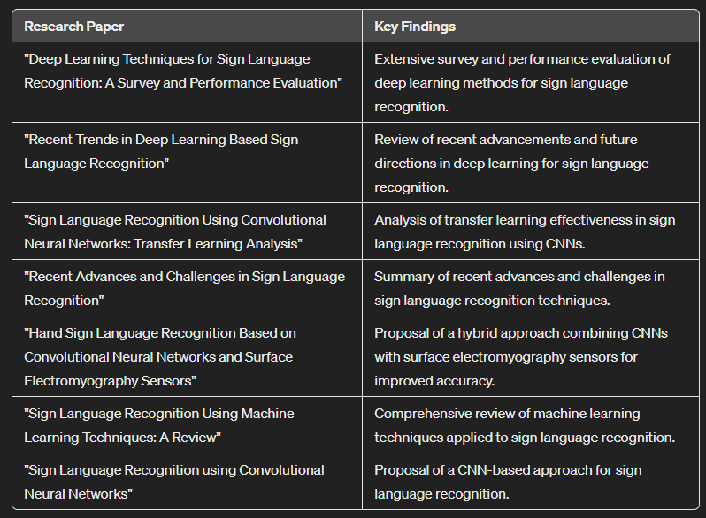
Literature Survey

Slide 7
Existing System / Work
Existing systems in sign language recognition include rule-based systems, template matching, machine learning approaches, sensor-based systems, and combined approaches.
Examples include sign language translation apps, gesture-controlled devices, and research prototypes. Ongoing research aims to improve their accuracy, speed, and usability.

Slide 8
Proposed System / Work
Proposed System:
Develop a real-time sign language recognition system using artificial intelligence (AI) techniques.
Utilize computer vision and machine learning algorithms to interpret sign language gestures accurately.
Aim to create an accessible and inclusive communication tool for the deaf and hard-of-hearing community.
Methodology:
Collect a diverse dataset of sign language gestures, covering a wide range of expressions and variations.
Preprocess the data to extract relevant features, such as hand shapes, movements, and positions.
Train a deep learning model, such as a convolutional neural network (CNN) or recurrent neural network (RNN), on the preprocessed dataset.
Implement the trained model in a real-time application to recognize sign language gestures from live video feeds.
Evaluate the system's performance through rigorous testing and validation, ensuring accuracy and reliability in gesture recognition.

Slide 9
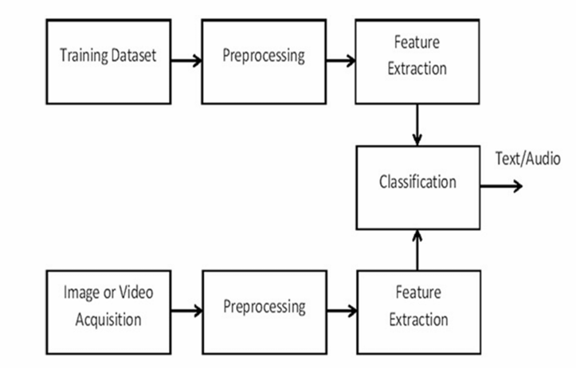
Architecture / Data Flow Diagram

Slide 10
Prototype / Application Developed
Importing Libraries: Necessary libraries such as OpenCV, NumPy, MediaPipe, and Keras are imported.
Media Pipe Hand Detection Setup: Media Pipe is configured for hand detection and tracking.
Data Preparation: Parameters for data collection are set, and directories for storing data are created.
Data Collection Loop: Iterates over actions, video sequences, and frames, detecting and saving hand landmarks.
Data Processing: Data.py script organizes collected landmarks, creates label mappings, and splits data for training.
Model Building and Training: A deep learning model is defined, compiled, and trained using prepared data.
Model Saving: Trained model is saved as JSON and H5 files.
Real-Time Detection: Trained model is loaded, video capture is initialized, and gestures are continuously detected and displayed in real-time.
Termination: Code can be terminated by pressing 'q' in the OpenCV window.

Slide 11
References
"Deep Learning Techniques for Sign Language Recognition: A Survey and Performance Evaluation" - Atef M. Ghalwash et al., IEEE Access, 2020
"Recent Trends in Deep Learning Based Sign Language Recognition" - Sanaullah et al., IEEE Access, 2020
"Sign Language Recognition Using Convolutional Neural Networks: Transfer Learning Analysis" - Paula Andrea Martinez et al., Sensors, 2020
"Recent Advances and Challenges in Sign Language Recognition" - Naveed Akhtar et al., Computer Vision and Image Understanding, 2019
"Hand Sign Language Recognition Based on Convolutional Neural Networks and Surface Electromyography Sensors" - Chun-Yu Chen et al., Sensors, 2019
"Sign Language Recognition Using Machine Learning Techniques: A Review" - Abdus Salam et al., Applied Sciences, 2019
"Sign Language Recognition using Convolutional Neural Networks" - Ahmad S. Khawaja et al., Proceedings of the 2019 International Conference on Artificial Neural Networks, 2019

